Slide 1


Intelligent Monitoring and Predicting Airborne Infection Risks in Hospital Environments Through ML-Enabled IoT Systems
VR SIDDHARTHA ENGINEERING COLLEGE, VIJAYAWADA
Department of Computer Science and Engineering
23AI&ML5554: B. Tech Epics (Final Review)
December 17th, 2025
Batch No: 8 (NON-ELITE)
Batch Members
N Venu Gopal - 238W1A4246
P Bhargav Reddy – 238W1A4248
K Puneeth – 238W1A4227
Under the Guidance of
Dr. Ch. Rupa
Professor

Slide 2
Abstract
Infection risk prediction in indoor healthcare environments has become increasingly important due to rising concerns about airborne diseases and poor air quality conditions. Effective infection control is crucial for minimizing healthcare-associated infections (HAIs), improving patient safety, and reducing healthcare costs. Existing monitoring methods often depend on manual inspections or isolated sensor readings, which lack scalability, accuracy, and real-time responsiveness. To address these limitations, this project proposes a smart infection risk detection system using the ESP32 Wroom-32 microcontroller integrated with environmental sensors—BME280, CCS811, and GP2Y1010AU0F. These sensors monitor key parameters such as temperature, humidity, pressure, CO₂, VOCs, and dust concentration. The collected multi-dimensional data is analyzed using the K-Means++ clustering algorithm to classify indoor spaces based on infection risk levels. This system offers continuous, autonomous monitoring, enabling early warnings and better management of infection-prone zones without human intervention.
Keywords: Infection risk prediction, Health care, Airborne diseases, Environmental sensors.

Slide 3
1. Aim and Motivation
Aim
To design and develop an IoT-enabled infection risk monitoring system that continuously measures hospital air quality parameters and uses Machine Learning to accurately predict airborne infection risks, helping healthcare staff take timely preventive actions.
Motivation
Airborne pathogens in hospitals increase the chances of infection spread among patients, visitors, and healthcare workers.
Hospitals currently lack continuous, data-driven monitoring of environmental parameters such as temperature, humidity, CO₂, and particulate matter.
Early detection of risky environmental conditions can significantly reduce hospital-acquired infections (HAIs).

Slide 4
2. Research Questions
How can multi-sensor IoT data (temperature, humidity, CO₂ levels, particulate matter, air quality) be leveraged to identify airborne infection-risk levels in hospital environments?
How effectively can a K-Means++ clustering model categorize indoor environments into Low, Moderate, and High infection-risk zones based on real-time environmental patterns?
How accurately can a cloud-based monitoring system deliver timely infection-risk alerts that support proactive decision-making and improve hospital safety?

Slide 5
3. Title Justification
The title includes Airborne Infection Risk Prediction, which reflects the system’s capability to assess and estimate the likelihood of infection spread through airborne particles in hospital environments rather than providing a general air-quality status.
The phrase IoT Sensors highlights the use of real-time environmental data from devices like BME280, CCS811, and GP2Y1010AU0F sensors.
Machine Learning represents the KMeans++ model used for prediction.
Hospital Environments indicates that the system is intended to improve overall indoor safety, minimize infection risks, and support effective monitoring practices in various healthcare settings.

Slide 6
4. Introduction
Project Overview
The project Airborne Infection Risk Prediction Using IoT Sensors and Machine Learning in Hospital Environments aims to help healthcare facilities identify and predict airborne infection risks in real time, ensuring safer indoor conditions for patients, doctors, and staff.
IoT sensors such as the BME280, CO₂ sensor, PM2.5 dust sensor, and TVOC sensor continuously collect environmental data like temperature, humidity, carbon dioxide levels, particulate matter, and air quality. This data is sent to a cloud platform where a Machine Learning model predicts whether the infection risk level is Low, Moderate, or High.
The system sends notifications to the healthcare staff, enabling quick corrective actions such as improving ventilation, reducing crowd density, or initiating infection control procedures.
Purpose and Scope
The purpose of this project is to create an efficient and reliable system that provides accurate airborne infection risk predictions using IoT sensor data and machine learning algorithms.
The system focuses on real-time data collection, cloud monitoring, ML-based risk classification, and alert generation, enabling hospitals to proactively manage indoor air quality and reduce infection spread.
The current scope is limited to sensor-based data acquisition, cloud storage, ML prediction, and alert notifications. It does not include automated HVAC control, robotic disinfection, or integration with hospital management software.

Slide 7
5.1 Study on Existing Technologies-I
Title: Air Quality and Dust Level Monitoring in Hospitals Using IoT
Journal Details: Discover Internet of Things, 2025 (Authors: A. Parkavi, B. J. Sowmya, S. A. Alex, et al.)
Dataset: Hospital indoor air quality and dust-level dataset
Description:
This paper presents an IoT-based air quality monitoring architecture specifically designed for hospital environments. The system uses sensors to collect particulate matter, temperature, and gas concentration values and transmits them through an IoT framework for real-time monitoring. The study demonstrates how IoT-driven environmental sensing can improve patient safety by identifying potentially harmful airborne conditions inside critical care areas.
Advantages:
Hospital-specific Application: Designed directly for clinical environments with real-world deployment.
Real-time Monitoring: Enables immediate detection of critical air quality variations.
Disadvantages:
1Sensor Calibration Needed: Accuracy depends heavily on frequent sensor recalibration.
Network Dependency: Requires robust Wi-Fi/IoT connectivity for uninterrupted monitoring.

Slide 8
5.2 Study on Existing Technologies-II
Title: Air Quality Monitoring and Control System for a Hospital Room
Journal Details: IEEE EHB Conference, 2021 (Authors: F. D. Andrei, G. Seritan, B. Enache, et al.)
Dataset: Hospital room indoor air quality dataset
Description:
The paper introduces a complete monitoring and control framework for hospital air quality. Using sensors for CO₂, temperature, and particulate matter, the system continuously evaluates environmental conditions and automatically activates control mechanisms such as ventilation adjustments. The work focuses on improving patient comfort and infection prevention through automated environmental regulation.
Advantages:
Automated Control: Not only monitors but also corrects air quality conditions.
High Clinical Relevance: Tailored for sensitive hospital room environments.
Disadvantages:
Hardware Intensive: Requires additional ventilation/actuator systems.
Higher Cost: Deployment complexity increases total system cost.

Slide 9
5.3 Study on Existing Technologies-III
Title: Fog-Based Machine Learning for Real-Time Environmental Monitoring in Smart Hospitals
Journal Details: IEEE Access, 2022 (Authors: A. Kouadri, A. Bouabdellah, Y. Challal)
Dataset: Hospital fog-computing environmental monitoring dataset
Description:
This work proposes a fog-computing architecture integrated with machine learning to perform real-time environmental analysis in hospitals. The system processes sensor data at the fog layer to reduce latency and enhance reliability. Machine learning models identify potential health risks related to air quality fluctuations, improving response time in critical care areas.
Advantages:
Low Latency Processing: Fog layer ensures faster decision-making than cloud-only models.
High Reliability: Reduces downtime during network disruptions.
Disadvantages:
Complex Architecture: Requires additional fog nodes and on-site computation units.
Higher Power Consumption: Fog devices increase energy usage.

Slide 10
5.4 Study on Existing Technologies-IV
Title: A Smart Framework for Indoor Air Quality Monitoring and Automated Ventilation Control
Journal Details: Journal of Ambient Intelligence and Humanized Computing, 2021 (Authors: A. De Paola, M. Ortolani, S. Gaglio, G. Lo Re)
Dataset: Indoor environmental monitoring dataset (CO₂, temperature, humidity)
Description:
This study proposes a smart indoor air quality (IAQ) monitoring framework combined with automated ventilation control. Environmental parameters are collected through sensors and analyzed to maintain optimal indoor conditions. Automated ventilation ensures that pollutant levels remain below health risk thresholds, supporting safer indoor occupancy.
Advantages:
Closed-Loop Control: Automatically regulates air quality levels.
Improved Comfort and Safety: Supports health compliance in indoor spaces.
Disadvantages:
Installation Complexity: Requires integration with existing ventilation infrastructure.
Limited to Closed Spaces: Not suitable for open or semi-open environments.

Slide 11
5.5 Study on Existing Technologies-V
Title: Wireless Sensor and Body Area Network Assisted Biosensor System for Preventing Hospital-Acquired Pneumonia.
Journal Details: Frontiers in Sustainable Cities, 2022 (Authors: Abubeker KM and Baskar S.).
Dataset: Patient biosensor and hospital environmental monitoring dataset
Description:
The paper explores a combined wireless sensor network (WSN) and body area network (BAN) architecture aimed at preventing non-ventilator hospital-acquired pneumonia. It integrates biosensors and environmental sensors to continuously observe patient health and environmental risks. The system provides early alerts for infection-prone conditions within hospital environments.
Advantages:
Early Detection: Focuses on identifying infection risks before escalation.
Multi-Sensor Integration: Combines patient and environmental data for better prediction.
Disadvantages:
Operational Complexity: Requires coordination between wearable and fixed sensors.
Energy Limitations: Wearable sensors face battery constraints.

Slide 12
5.6 Study on Existing Technologies-VI
Title: Infection Risk Prediction in Healthcare Settings: Lessons from COVID-19
Journal Details: Infectious Diseases and Clinical Microbiology, 2024 (Authors: S. Keskin, S. Emecen, A. Ergör)
Dataset: Clinical contact-tracing and environmental risk dataset
Description:
This paper examines infection transmission patterns in healthcare settings and proposes predictive approaches for risk assessment. It highlights how environmental factors, occupancy patterns, and contact behavior influence airborne infection spread. The study provides methodologies that can be adapted into ML-based risk prediction systems.
Advantages:
Strong Conceptual Foundation: Provides epidemiological insights useful for ML modeling.
Healthcare-Focused: Based entirely on clinical infection risk scenarios.
Disadvantages:
Not Sensor-Based: Focuses more on epidemiology than IoT sensor networks.
Limited Quantitative Models: Does not provide ready-to-use ML algorithms.

Slide 13
5.7 Study on Existing Technologies-VII
Title: Built Environment Considerations to Reduce Airborne Transmission During COVID-19
Journal Details: mSystems, 2020 (Authors: L. Dietz, P. Horve, D. Coil, et al.)
Dataset: Built-environment viral transmission dataset
Description:
This paper provides an in-depth analysis of how airborne viruses spread within indoor spaces and how environmental factors such as ventilation, humidity, and particulate concentration contribute to transmission. The study outlines built environment strategies for minimizing infection risk, supporting design decisions for IoT-based monitoring systems.
Advantages:
High Relevance to Airborne Pathogens: Strong focus on airborne transmission modes.
Scientifically Grounded: Backed by validated environmental health studies.
Disadvantages:
No IoT Integration: Does not describe sensor-based monitoring.
Generalized Recommendations: Lacks ML or computational modeling components.

Slide 14
5.8 Study on Existing Technologies-VIII
Title: IoT for Smart Healthcare: Concepts, Technologies, and Applications
Journal Details: Book Chapter, 2024 (Authors: E. M. N. Sharmila, K. Rama Krishna, G. N. R. Prasad, et al.)
Dataset: Various healthcare IoT datasets (environmental and physiological)
Description:
The chapter introduces the architecture and working principles of IoT in healthcare. It explains IoT sensor deployment, communication technologies, cloud integration, and analytics methods. The content serves as a foundational overview for IoT systems used to monitor environmental health indicators in hospital settings.
Advantages:
Broad Coverage: Offers a complete understanding of IoT healthcare ecosystems.
Strong Theoretical Foundation: Useful for explaining IoT architecture in your project.
Disadvantages:
Not Experiment-Based: Lacks empirical results or hardware implementation.
General Scope: Not focused specifically on airborne infection risk.

Slide 15
5. Study on Existing Technologies
S. No. | Article Title | Journal Details | Algorithms/ Models | Dataset | Advantages | Disadvantages
1 | Air Quality and Dust Level Monitoring in Hospitals Using IoT | Discover Internet of Things, 2025 | IoT sensing + threshold-based monitoring | Hospital indoor air quality & dust dataset | 1. Real-time monitoring improves patient safety | 1.Require regular calibration
 |  |  |  |  | 2Designed for real hospital environments | 2Depends on stable IoT connectivity
2 | Air Quality Monitoring and Control System for a Hospital Room | IEEE EHB Conference, 2021 | Sensor fusion + automated control logic | Hospital patient-room IAQ dataset | 1. Automated ventilation control | 1. Requires actuator/ventilation hardware
 |  |  |  |  | 2. High clinical relevance | 2. Higher overall deployment cost
3 | Fog-Based Machine Learning for Real-Time Environmental Monitoring in Smart Hospitals | IEEE Access, 2022 | Fog ML classifiers (SVM, Decision Trees) | Smart hospital fog-layer monitoring dataset | 1. Low latency processing | 1. Complex fog architecture
 |  |  |  |  | 2. Highly reliable in network failures | 2. Increased energy consumption
4 | A Smart Framework for Indoor Air Quality Monitoring and Automated Ventilation Control | Journal of Ambient Intelligence and Humanized Computing, 2021 | IAQ monitoring + rule-based ventilation control | Indoor CO₂, Temp, Humidity dataset ) | 1. Closed-loop automated control | 1. Requires integration with HVAC systems
 |  |  |  |  | 2. Improves indoor comfort & safety | 2. Limited to enclosed environments

Slide 16
5. Study on Existing Technologies
S. No. | Article Title | Journal Details | Algorithms/ Models | Dataset | Advantages | Disadvantages
5 | Wireless Sensor and Body Area Network Assisted Biosensor System for Preventing Hospital-Acquired Pneumonia | Frontiers in Sustainable Cities, 2022 | WSN + BAN health risk detection | Biosensor + hospital environmental dataset | 1. Early infection-risk detection | 1. Wearable sensor battery limitations
 |  |  |  |  | 2. Multi-sensor data improves accuracy | 2. Complex multi-network coordination
6 | Infection Risk Prediction in Healthcare Settings: Lessons from COVID-19 | Infectious Diseases and Clinical Microbiology, 2024 | Statistical risk prediction models | Clinical contact-tracing & risk datasets | 1.Strong epidemiological foundation | 1Not sensor/IoT focused
 |  |  |  |  | 2 Highly relevant to infection prediction | 2. Lacks ML-based quantitative modelling
7 | Built Environment Considerations to Reduce Airborne Transmission During COVID-19 | mSystems, 2020 | Environmental risk analysis | Indoor built-environment viral transmission dataset | 1. Focuses on airborne pathogen behavior | 1. No IoT/ML integration
 |  |  |  |  | 2. Strong scientific evidence base | 2.General recommendations, not system-specific
8 | IoT for Smart Healthcare: Concepts, Technologies, and Applications | Book Chapter, 2024 | IoT architecture + cloud monitoring | Multiple healthcare IoT datasets | 1. Strong theoretical IoT foundation | 1. No experimental validation
 |  |  |  |  | 2.Useful for system design and architecture | 2. Very broad scope, not infection-specific

Slide 17
6. Gap Analysis
Existing hospital air quality monitoring approaches show several limitations:
Lack of continuous, real-time environmental surveillance.
Minimal use of ML-based prediction models for infection risk assessment.
Most systems focus only on gas or particulate monitoring without multi-sensor integration.
Limited alerting capabilities when risk thresholds are exceeded.
Insufficient data-driven decision support for healthcare workers.

Slide 18
7. Objectives
To design and develop an IoT-based system that continuously monitors air quality parameters such as temperature, humidity, CO₂, VOCs, and dust levels in hospital environments.
To implement a machine learning model (K-Means clustering) for classifying infection risk levels into Low, Medium, and High categories based on real-time sensor data.
To integrate cloud computing (ThingSpeak platform) for data storage, visualization, and remote monitoring of hospital air quality.
To develop an automated alert system that notifies healthcare staff when infection risk levels rise beyond safe limits.
To evaluate system performance in real-world environments, ensuring accuracy, reliability, and scalability for future hospital implementations

Slide 19
8. Scope
This system is designed mainly for hospital indoor spaces such as wards and ICUs, where infection risk is highest.
It keeps track of important factors like temperature, humidity, air quality, and dust levels that directly affect the spread of airborne diseases.
All this information is processed and visualized in real time using the ThingSpeak cloud platform.
Based on the data, the system can predict infection risks and send timely alerts so that hospital staff can take quick preventive measures.
Although focused on hospitals, this solution can also be extended to schools, offices, and other public spaces to improve overall health and safety.

Slide 20
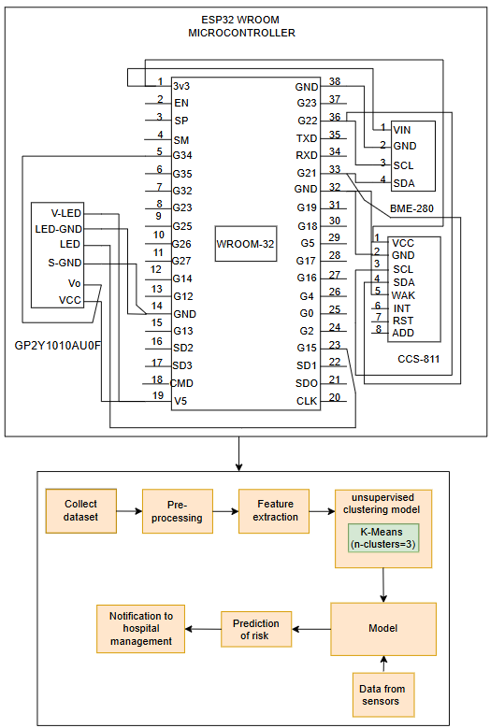
9.1. Proposed Model
Sensor nodes deployed inside the hospital environment continuously capture indoor parameters such as temperature, humidity, CO₂ concentration, particulate matter (PM2.5/PM10), and air quality using BME280, CCS811, GP2Y1010AU0F, and CO₂ sensors.
The ESP32 microcontroller aggregates the captured sensor readings, performs basic validation, and transmits the data to the cloud platform in real time using Wi-Fi.
The cloud platform stores and structures the data, performs initial preprocessing, and makes the environmental information available for machine learning–based analysis.
The K-Means++ clustering algorithm processes the environmental readings and groups them into three major clusters representing Low, Moderate, and High airborne infection risk levels.
When the predicted cluster indicates a High-risk condition, the system alerts healthcare personnel to take preventive measures such as improving ventilation, reducing occupancy, or initiating infection-control procedures.
A real-time notification is generated automatically and sends email whenever the infection risk crosses a predefined threshold for any hospital zone.
Figure: Proposed model system architecture.

Slide 21
9.2. Modules of Proposed Model
Module 1 Name: IoT Sensor Acquisition Module
This module refers to the ESP32-based sensing unit that collects real-time indoor environmental data such as temperature (BME280), humidity (BME280), air quality (CCS811), particulate matter (GP2Y1010AU0F), and CO₂ levels.
Module 2 Name: Data Preprocessing & Feature Extraction Module
This module handles filtering, preprocessing, normalization, and feature extraction from the sensor data to prepare it for the unsupervised clustering model.
Module 3 Name: Unsupervised Clustering & Risk Prediction Module
This module applies the K-Means++ clustering algorithm to group environmental conditions into meaningful clusters representing Low, Moderate, and High infection-risk levels.
Module 4 Name: Alert & Notification Handling Module
This module evaluates the predicted cluster result and, when risk is high, triggers emergency notifications and email alerts and telegram notifications to hospital management for quick response.

Slide 22

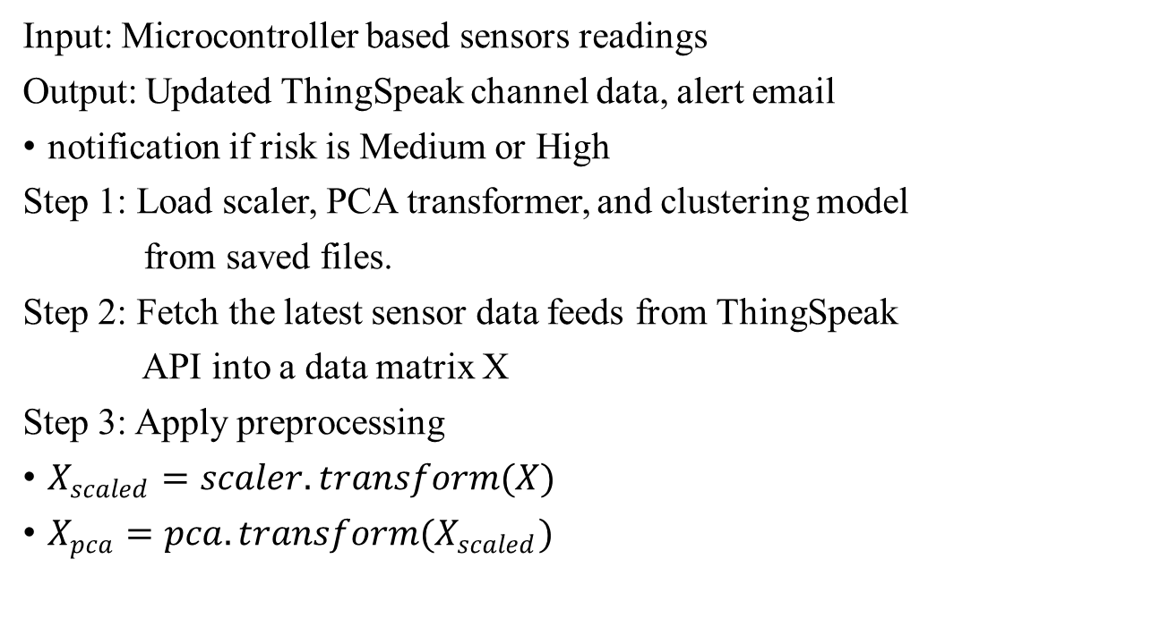
9.3. Algorithms/Pseudo Codes
Input: Microcontroller based sensors readings
Output: Updated ThingSpeak channel data, alert email
notification if risk is Medium or High
Step 1: Load scaler, PCA transformer, and clustering model
from saved files.
Step 2: Fetch the latest sensor data feeds from ThingSpeak
API into a data matrix X
Step 3: Apply preprocessing
$X_{scaled}=scaler.transform(X)$
$X_{pca}=pca.transform(X_{scaled})$

Slide 23
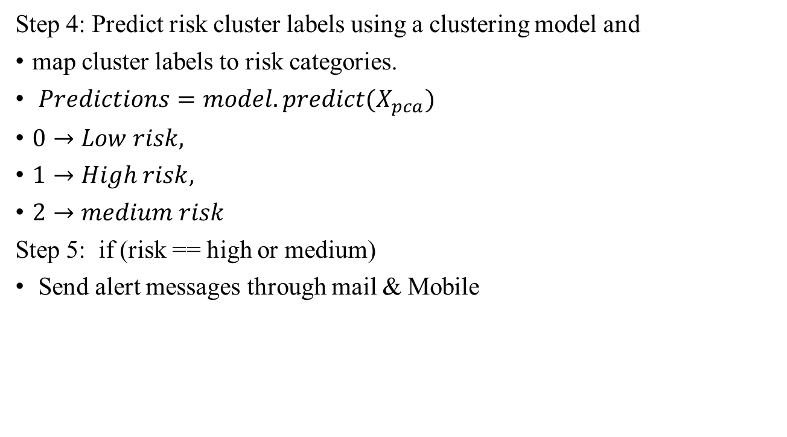
9.3. Algorithms/Pseudo Codes
Step 4: Predict risk cluster labels using a clustering model and
map cluster labels to risk categories.
$Predictions=model.predict(X_{pca})$
$0→Low risk,$
$1→High risk,$
$2→medium risk$
Step 5: if (risk == high or medium)
Send alert messages through mail & Mobile

Slide 24
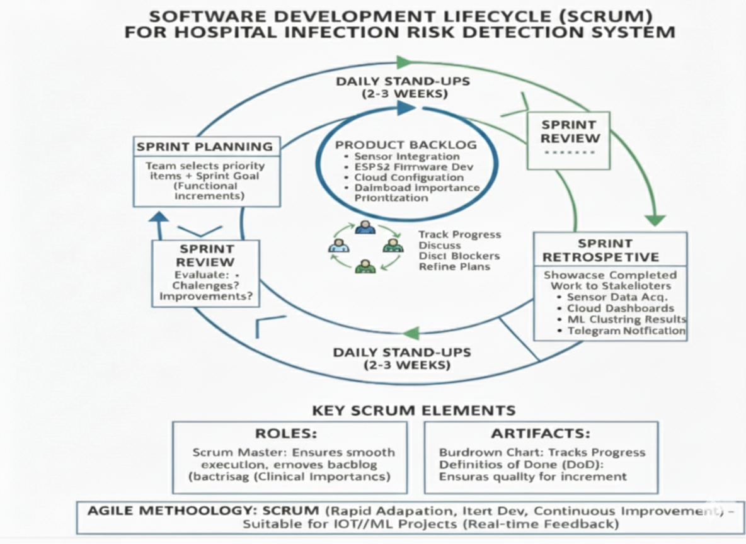
10. SDLC Model
Figure: SDLC process of the Infection Risk System using IoT and Machine Learning.

Slide 25
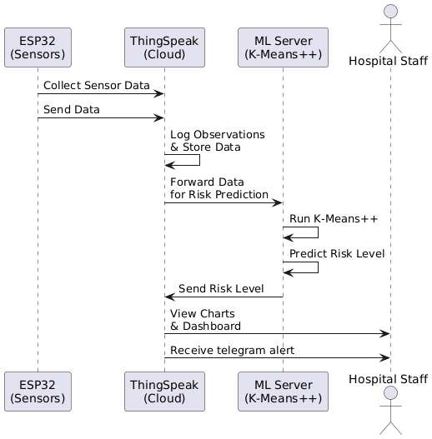
11.1. Sequence Diagram
Figure: Sequence Diagram of the Infection Risk Prediction System(IoT Device, Cloud Server & ML).

Slide 26
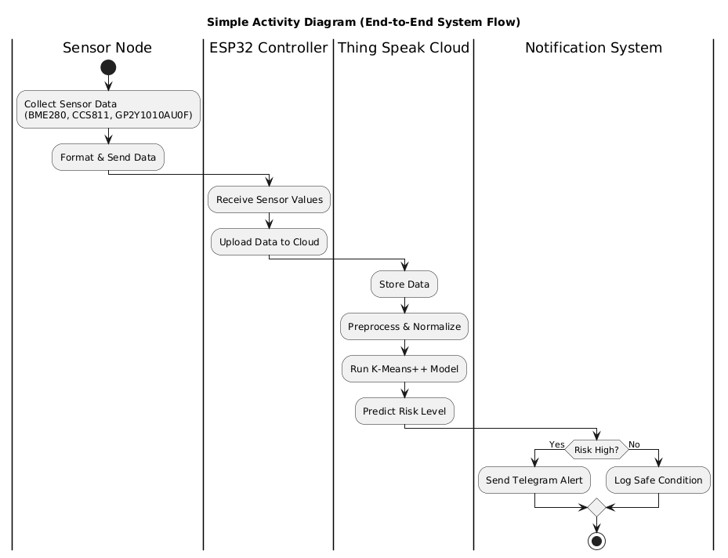
11.2. Activity Diagram
Figure: Activity diagram of the Infection Risk Prediction System using IoT, Machine Learning, and Alerts.

Slide 27
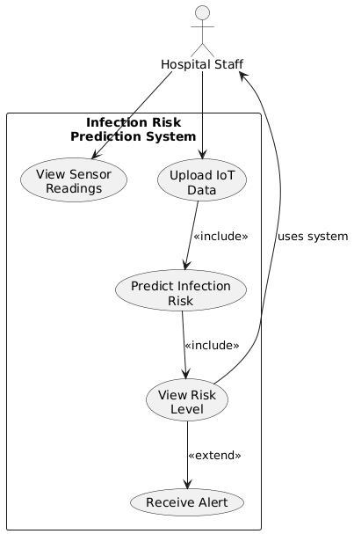
11.3. Use Case Diagram
Figure: Use case representation of the Infection Risk Prediction System.

Slide 28
12. Functional and Non-Functional Requirements
Table 12.1 Functional Requirements
S.No | Functional Requirement | Description
1 | Real-time Sensor Data Collection | The system collects temperature, humidity, CO₂ levels, particulate matter (PM2.5/PM10), and TVOC readings continuously using sensors like BME280, CCS811, Dust sensor.
2 | Wireless Data Transmission | ESP32 transmits all sensor readings to the ThingSpeak cloud for storage and analysis.
3 | Data Preprocessing | The system filters noise, formats values, and prepares sensor data for prediction.
4 | Infection Risk Prediction | The Machine Learning model (KMeans++) predicts the infection risk level as Low, Moderate, or High based on IoT sensor inputs.
5 | Notification Generation | When the risk level becomes high, the system sends alerts such as email and telegram notifications to healthcare staff.
6 | Cloud Monitoring Dashboard | The cloud interface displays real-time sensor values, risk categories, historical trends, and provides continuous monitoring support..

Slide 29
12. Functional and Non-Functional Requirements
Table 12.2 Non-Functional Requirements
S.No | Non-Functional Requirement | Description
1 | Performance | The system must process sensor data and generate risk predictions with minimal delay (within 1–5 seconds).
2 | Accuracy | The ML model should maintain high prediction accuracy with reliable classification of infection risk levels.
3 | Reliability | Sensor communication and cloud updates must function consistently without frequent failures.
4 | Maintainability | The system should allow easy updates to sensors, ML models, or cloud configurations.
5 | Availability | The monitoring system must remain active 24/7 with minimal downtime to ensure continuous safety.
6 | Scalability | The system must support multiple rooms, wards, or hospital zones without performance degradation.

Slide 30
13. Dataset Description
BME280 – Temperature (°C), Humidity (%), Pressure (hPa)
Name of the Dataset: Hospital Indoor Air Quality & Infection-Risk Sensor Dataset
(Custom Collected Dataset)
Description:
This dataset is generated from an ESP32-based IoT setup deployed in indoor hospital-like environments. It records real-time environmental parameters that strongly influence airborne infection spread. Data was collected using the following sensors:
BME280 – Temperature (°C), Humidity (%), Pressure (hPa)
CCS811 – TVOC (ppb), eCO₂ (ppm)
GP2Y1010AU0F – PM2.5 / Dust concentration (mg/m³)
The dataset captures a wide range of natural fluctuations generated by human movement, ventilation changes, crowd density variations, and ambient environmental disturbances. These real-world variations, combined with minor sensor noise, create a rich and diverse data distribution that strengthens the learning process. With 2037 high-quality sensor records, the dataset provides more than enough depth for unsupervised training, ensuring that the K-Means++ model can reliably recognise meaningful patterns and separate the environment into Low, Moderate, and High airborne infection-risk clusters. This variability directly improves the model’s robustness and accuracy when deployed in real hospital conditions.

Slide 31
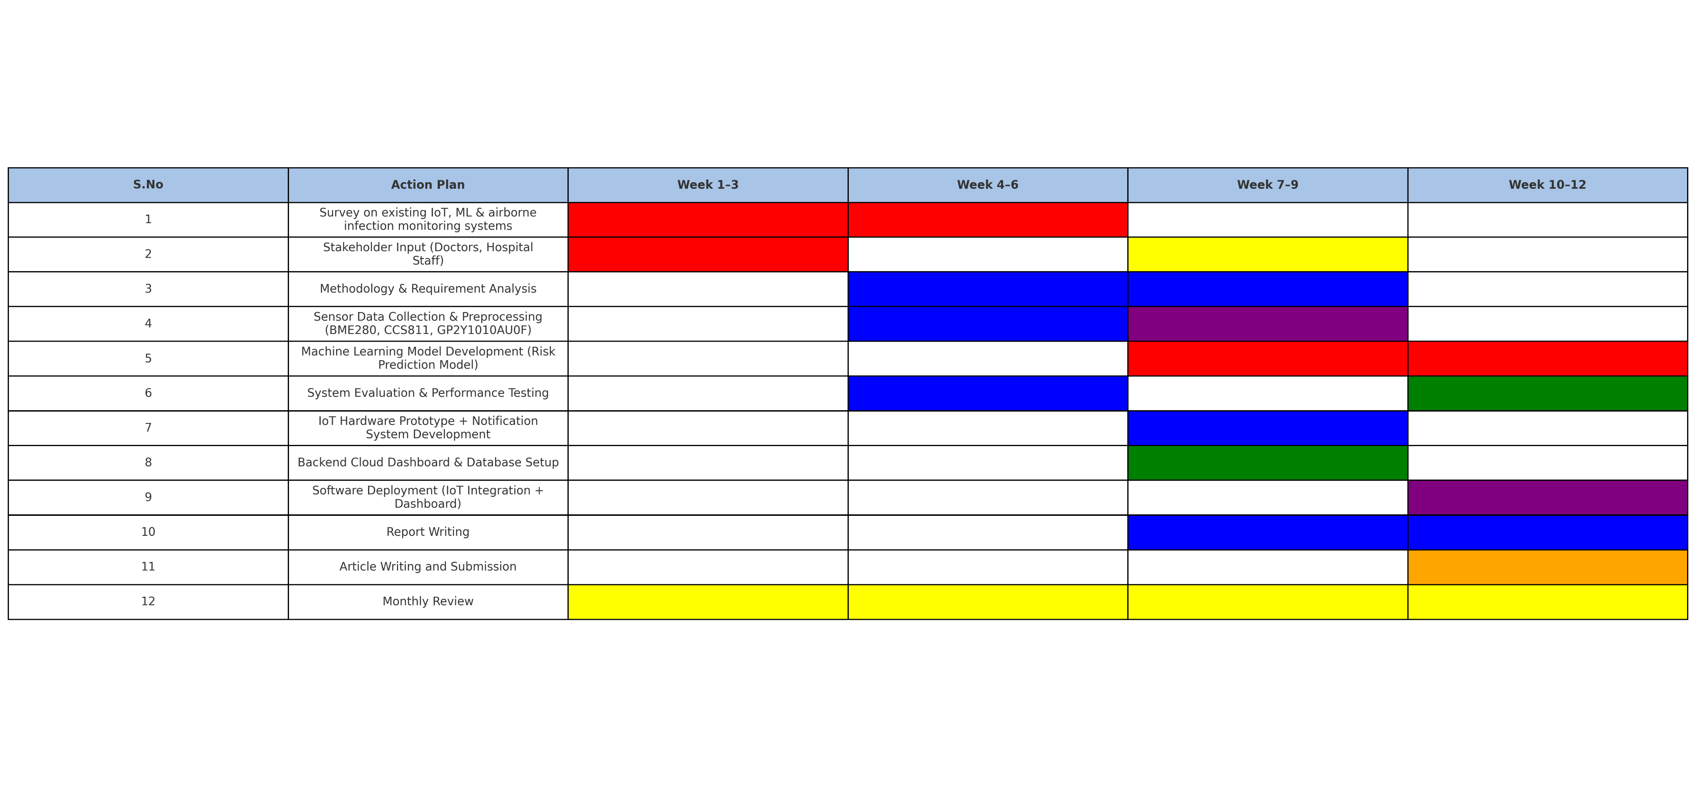
14. Timeline Chart
Table : Timeline chart for EPICS work

Slide 32
15. Summary
We discussed the problem of airborne infection spread in hospitals and the need for continuous indoor monitoring.
IoT sensors such as BME280, CCS811, CO₂, and dust sensors were used to collect real-time environmental data.
The collected data was preprocessed through cleaning, normalization, and feature extraction to prepare it for machine learning analysis.
A K-Means++ clustering model was developed to group environmental conditions and identify potential Low, Moderate, and High infection-risk zones.
The system generates alerts when readings fall into high-risk clusters, helping staff take preventive measures.
Results showed that the model effectively detected risky patterns and improved indoor safety monitoring.

Slide 33
References
Parkavi, A., Sowmya, B.J., Alex, S.A. et al. Air quality and dust level monitoring systems in hospitals using IoT. Discov Internet Things 5, 23 (2025). https://doi.org/10.1007/s43926-025-00120-w
F. D. Andrei, G. Seritan, B. Enache, F. C. Argatu and F. . -. C. Adochiei, "Air Quality Monitoring and Control System for a Hospital Room," 2021 International Conference on e-Health and Bioengineering (EHB), Iasi, Romania, 2021, pp. 1-4, doi: 10.1109/EHB52898.2021.9657663.
A. Kouadri, A. Bouabdellah, and Y. Challal, “Fog-Based Machine Learning for Real-Time Environmental Monitoring in Smart Hospitals,” IEEE Access, vol. 10, pp. 16077–16087, 2022. https://doi.org/10.1109/ACCESS.2022.3149638
A. De Paola, M. Ortolani, S. Gaglio, and G. Lo Re, “A Smart Framework for Indoor Air Quality Monitoring and Automated Ventilation Control,” Journal of Ambient Intelligence and Humanized Computing, vol. 12, no. 6, pp. 6737–6749, 2021. https://doi.org/10.1007/s12652-020-02611-6.

Slide 34
References
Abubeker KM and Baskar S (2022) Wireless sensor and wireless body area network assisted biosensor network for effective monitoring and prevention of non-ventilator hospital-acquired pneumonia. Front. Sustain. Cities 4:1063067. doi: 10.3389/frsc.2022.1063067
Keskin S, Emecen AN, Ergör A. Infection Risk Prediction in Healthcare Settings: Lessons from COVID-19 Contact Tracing. Infect Dis Clin Microbiol. 2024 Mar 8;6(1):44-54. doi: 10.36519/idcm.2024.315. PMID: 38633443;
L. Dietz, P. F. Horve, D. A. Coil, M. Fretz, J. A. Eisen, and K. V. D. Wymelenberg, “2019 Novel Coronavirus (COVID-19) Pandemic: Built Environment Considerations To Reduce Transmission,” mSystems, vol. 5, no. 2, 2020. https://doi.org/10.1128/mSystems.00245-20
E. M. N. Sharmila, K. Rama Krishna, G. N. R. Prasad, Byram Anand, Chetna Vaid Kwatra, Dhiraj Kapila. Internet of Medical Things for Smart Healthcare: Concepts, Technologies, and Applications, Book Chapter, In: Satya Prakash Yadav, Sudesh Yadav, Pethuru Raj Chelliah, Victor Hugo C. de Albuquerque (Eds.), 2024.

